Slide 1
United States Redistricting: Lessons For Mexico
Michael McDonald
University of Florida
www.electproject.org ● @ElectProject

Slide 2


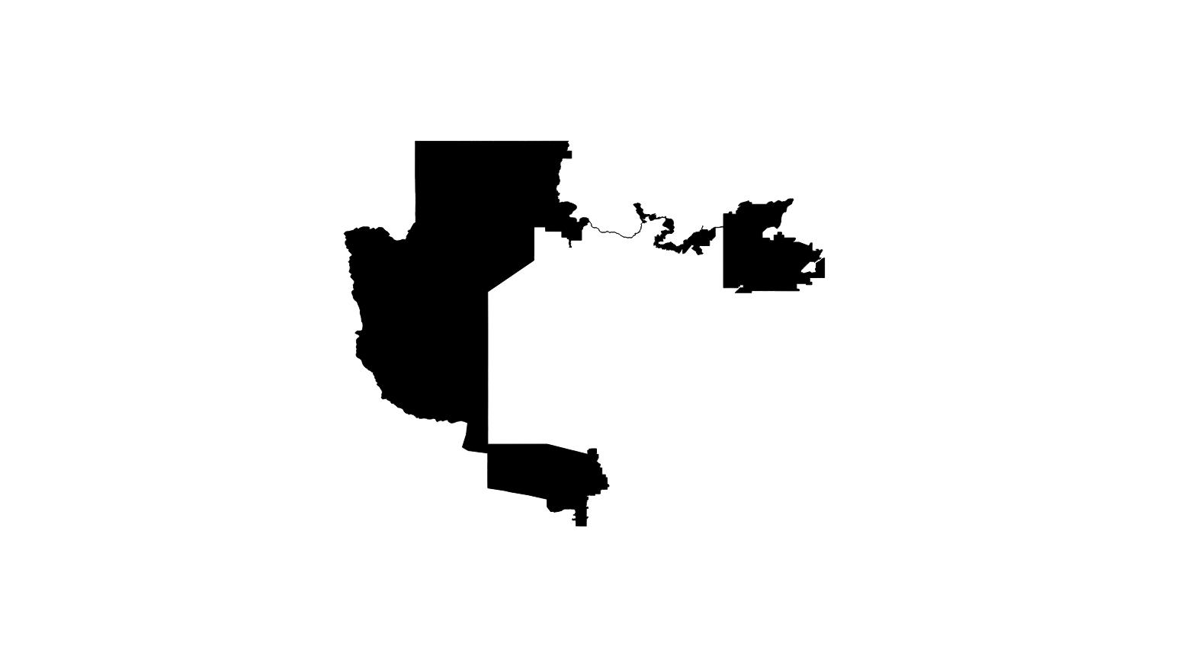
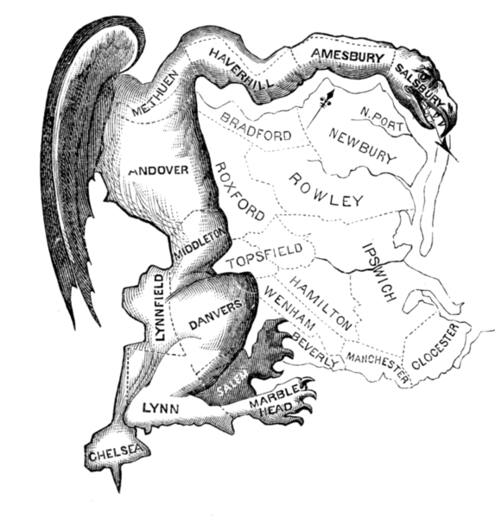
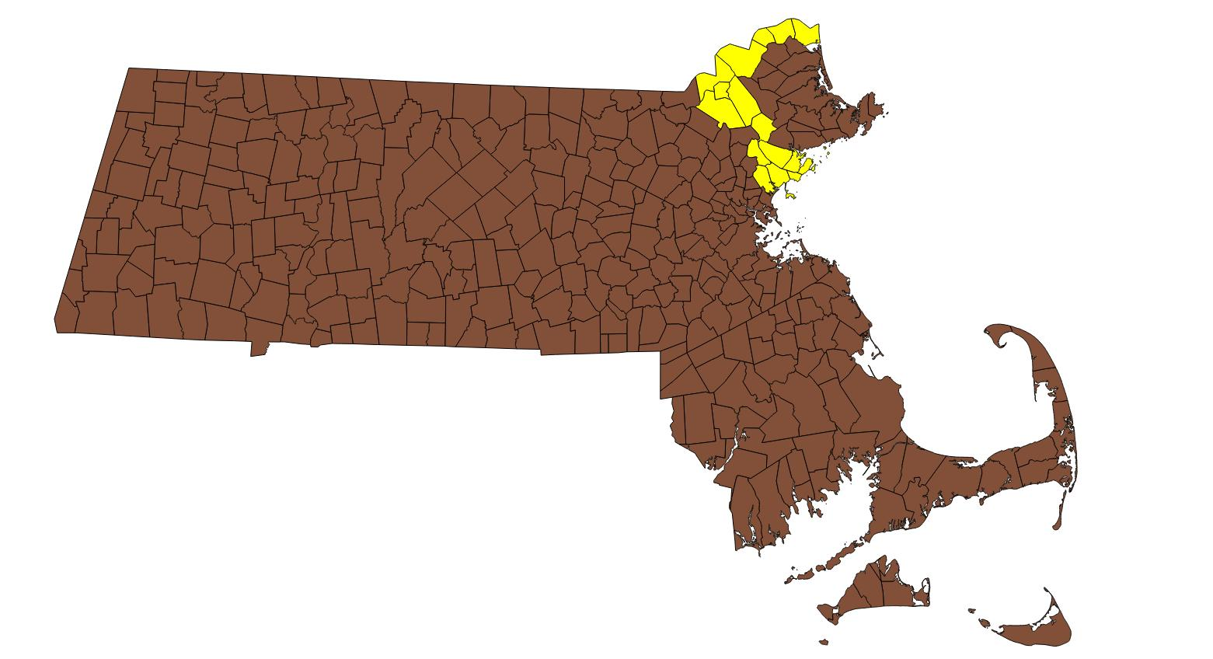
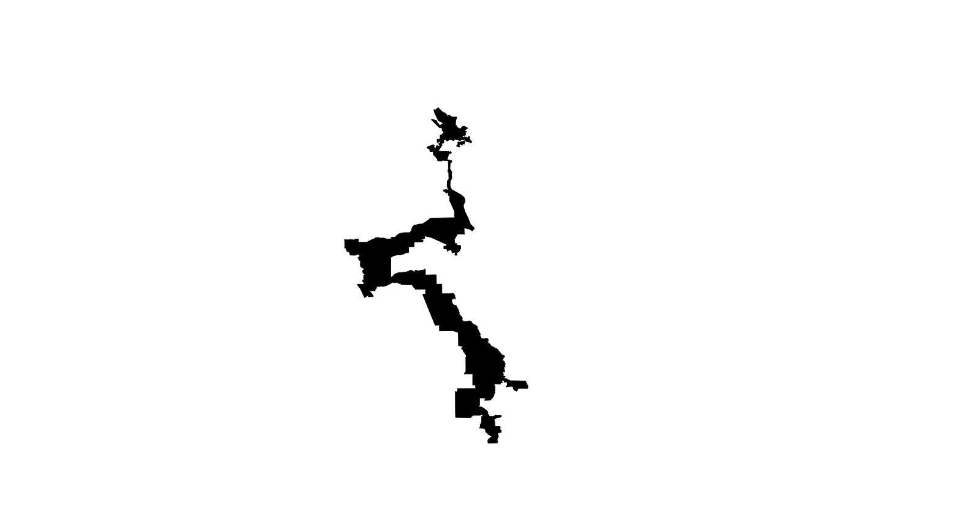




Slide 3
United States Redistricting
Decentralized
Each state has different processes and criteria
Political
If one party controls process, they will produce a partisan gerrymander
If divided control, bipartisan compromise results or courts intervene
Litigated
Federal and state courts frequently adjudicate allegations of constitutional and statutory violations

Slide 4
The Legal Criteria
1960s: Supreme Court Rules Districts Must Be of Equal Population
New Census → New Districts
1965 Voting Rights Act & 14th Amendment
Minority Representation
Additional State Criteria
Contiguity, Compactness, Respect Political Boundaries, Nesting, Communities of Interest, and Retention of District Cores
Political Considerations
Partisanship and Incumbent Protection

Slide 5
The Legal Criteria
1960s: Supreme Court Rules Districts Must Be of Equal Population
New Census → New Districts
1965 Voting Rights Act & 14th Amendment
Minority Representation
Additional State Criteria
Contiguity, Compactness, Respect Political Boundaries, Nesting, Communities of Interest, and Retention of District Cores
Political Considerations
Partisanship and Incumbent Protection

Slide 6
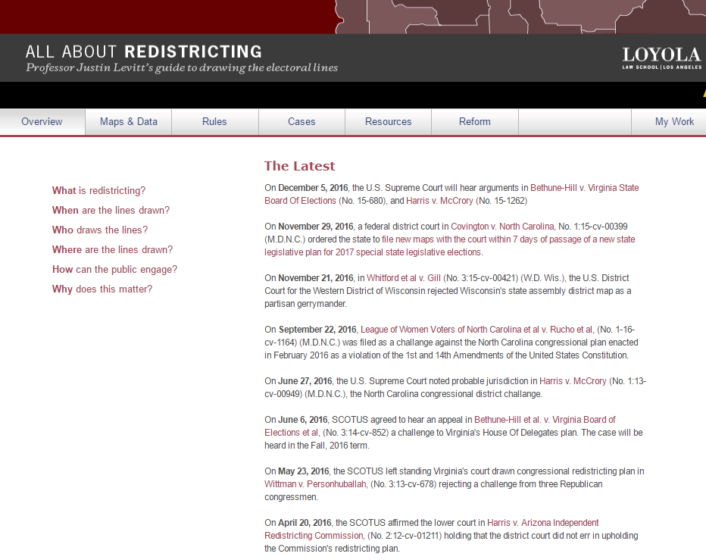
All About Redistricting
http://redistricting.lls.edu/

Slide 7
Minority Representation
Cracking
Packing
Notes:
Sadly, many techniques to deprive minorities of a meaningful vote.
At-large: Many districts with multiple seats were kept as “at-large” districts. In these districts, the majority vote would predictably beat the minority vote for every seat. In this district, there are 20 (say) white voters and 16 minority voters. And the majority will win every time.
Districts can improve the situation, but they don’t necessarily do so. One district-based technique is called “cracking”: split the minority community up so that its voting power is diluted. Here, each district has 5 white voters and 4 minority voters.
In “packing”, the objective is to cram as many minorities as possible into one district, to limit minority power to that one over-full district. Minorities are “bleached” from the surrounding areas, leaving the white voters firmly in control.

Slide 8
Minority Representation
US Courts currently addressing what percentage of minorities need to be placed in a district necessary to elect a minority candidate of choice (Bethune-Hill v. Virginia, Harris v. McCrory, Brown v. Detzner, Alabama Legis. Black Caucus v. Alabama)
Candidate of choice does not need to be the same race or ethnicity of the minority group
Some voters in the majority will crossover to vote for minority candidate of choice
The exact percentage of minorities needed to elect a candidate of choice is determined by statistical analyses of voting patterns
In some districts, the percentage of minorities needed can be less than 50%

Slide 9
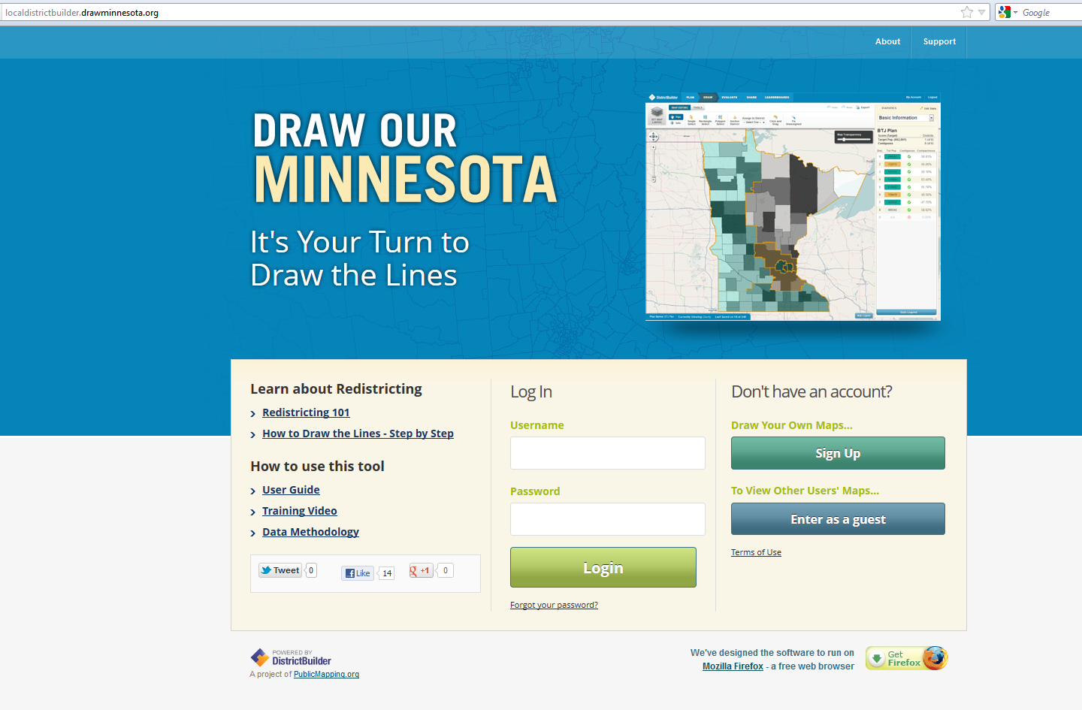
The Public Mapping Project www.publicmapping.org
Supported by
The Sloan Foundation
Joyce Foundation
Amazon Corporation
Judy Ford Wason Center at Christopher Newport Univ.
Michael McDonald
University of Florida
Brookings Institution
Micah Altman
MIT
Brookings Institution
Robert Cheetham
Azavea
Awards:
Strata Innovation Award
Tides Pizagitti Prize
American Political Science Association
Notes:
This work. “The Public Mapping Project”, by Micah Altman (http://redistricting.info) is licensed under the Creative Commons Attribution-Share Alike 3.0 United States License. To view a copy of this license, visit http://creativecommons.org/licenses/by-sa/3.0/us/ or send a letter to Creative Commons, 171 Second Street, Suite 300, San Francisco, California, 94105, USA.

Slide 10

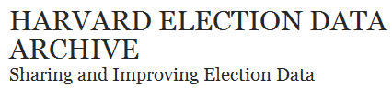
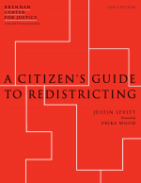
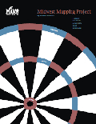
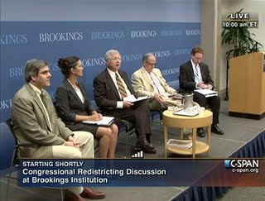
Four Pillars to Public Mapping Success
Software Development
Data Collection
Public Education
Dissemination

Slide 11
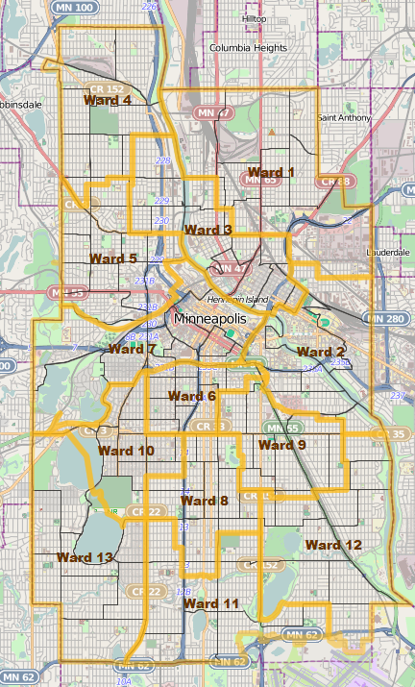
Communities of Interest
Minneapolis, Minnesota City Council Redistricting
In 2011, Newly formed citizen commission used our software
Somali and Latino community groups drew districts for their communities, shared these districts with the commission
Commission adopted the proposed districts
In 2012, Minneapolis elected their first Somali and Latino city councilmembers

Slide 12
Detecting Gerrymandering
US Courts have relied on evolution of redistricting plans during the redistricting process (Whitford v. Gill, Brown v. Detzner)
Transparency of the process important since it provides the courts more evidence to adjudicate constitutional and statutory violations
US Courts also analyze alternative plans to detect violations of constitutional or statutory criteria (Common in voting rights cases, but also see Holt v. 2011 Legislative Reapportionment Comm'n)
If a plan exists that conforms better on mandatory criteria than the adopted plan, a gerrymandering exists

Slide 13
Incumbents
New issue for Mexico’s redistricting since members can now run for reelection
US Supreme Court has ruled incumbency protection is a legitimate goal (e.g., Miller v Johnson)
Incumbents are known to have cut potential future challengers out of their district (e.g., President Obama)
Some states forbid their redistricting authority to favor any candidate, including incumbents. Some states forbid redistricting authoring from knowing the location of incumbent homes

Slide 14
United States Redistricting: Lessons For Mexico
Michael McDonald
University of Florida
www.electproject.org ● @ElectProject

